Slide 1

Virtual-Thing: Thing Description based Virtualization
Second W3C Workshop on the Web of Things 3-5 June 2019, Munich, Germany
Hassib Belhaj
Ege Korkan
Sebastian Steinhorst
Technical University of Munich

Slide 2
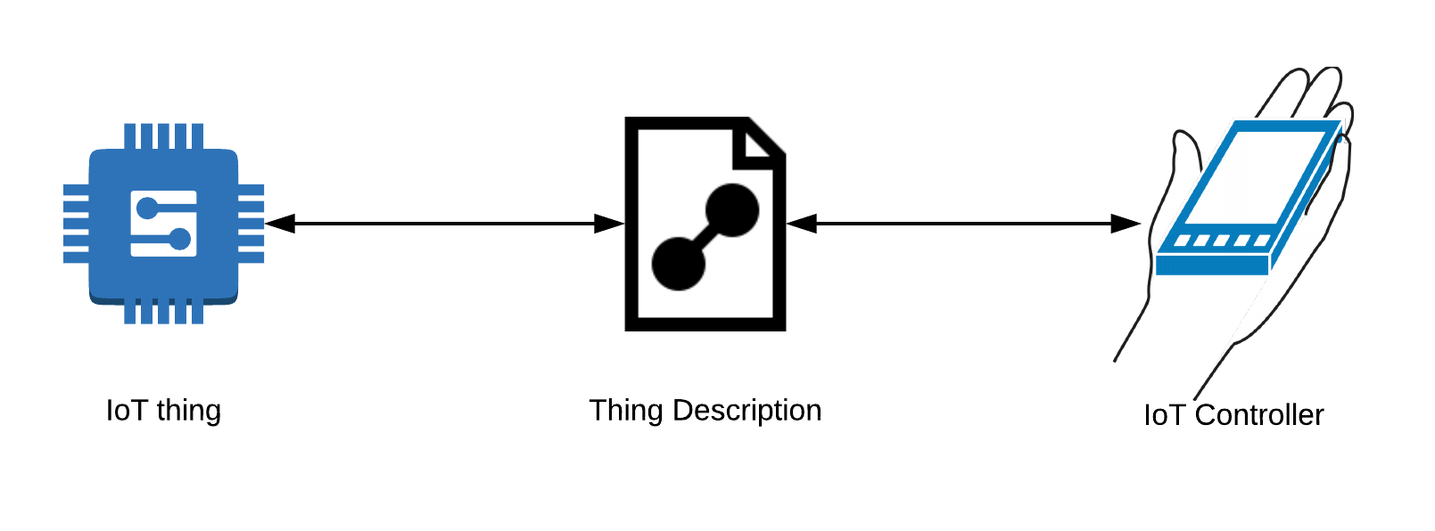
Introduction
Any W3C WoT device can have a Thing Description, telling other devices / controller how to interact with it.

Slide 3
Problem
No easy way to simulate a thing based on it’s TD
Hard to test your mashup without physical access to the device
Running tests might overwhelm the tested thing

Slide 4
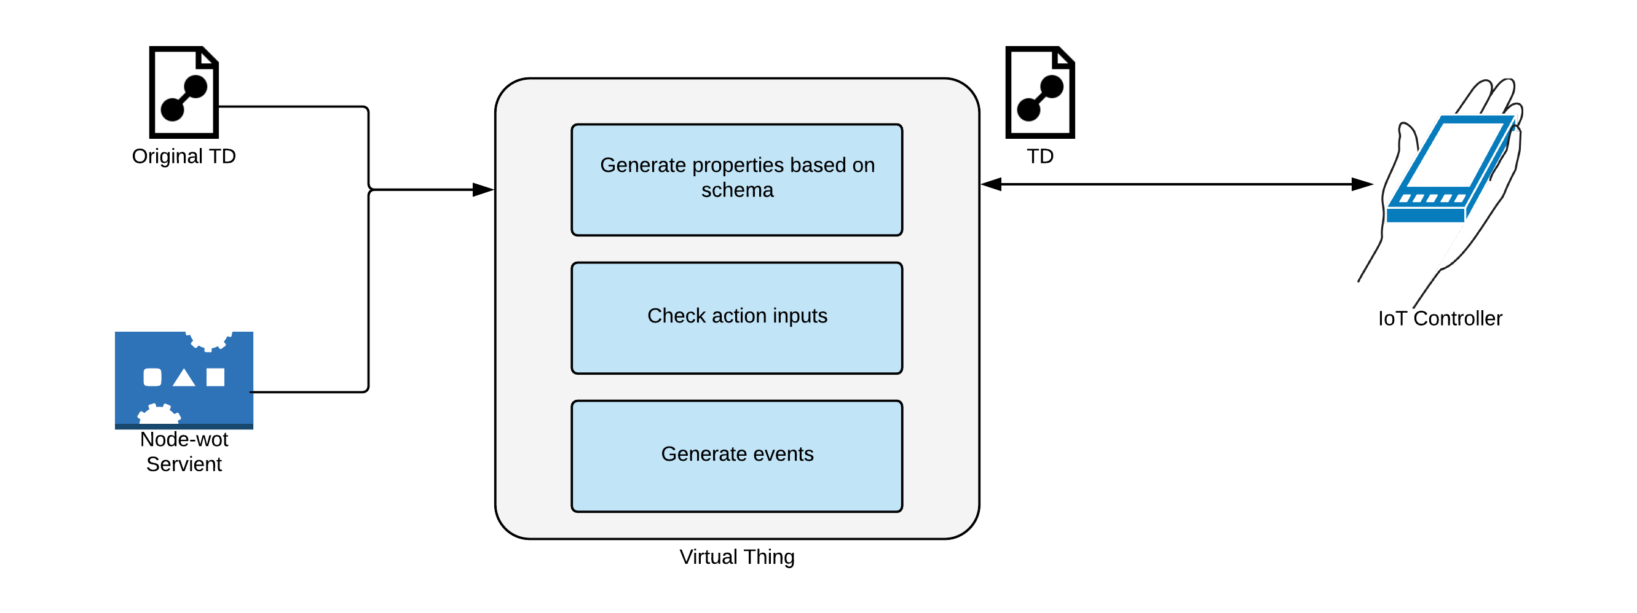
Virtual Thing
Simulate a thing based only on it’s Thing Description

Slide 5
Virtual Thing
Data is generated using the JSON Schema in the TD
Properties can be written and will keep that value
Inputs for actions are verified and must be in correct format
Event generation can be set to: off, random intervals or a preconfigured interval

Slide 6
How to use it
Available on NPM
Easy to start
npm install virtual-thing
virtual-thing td.json

Slide 7
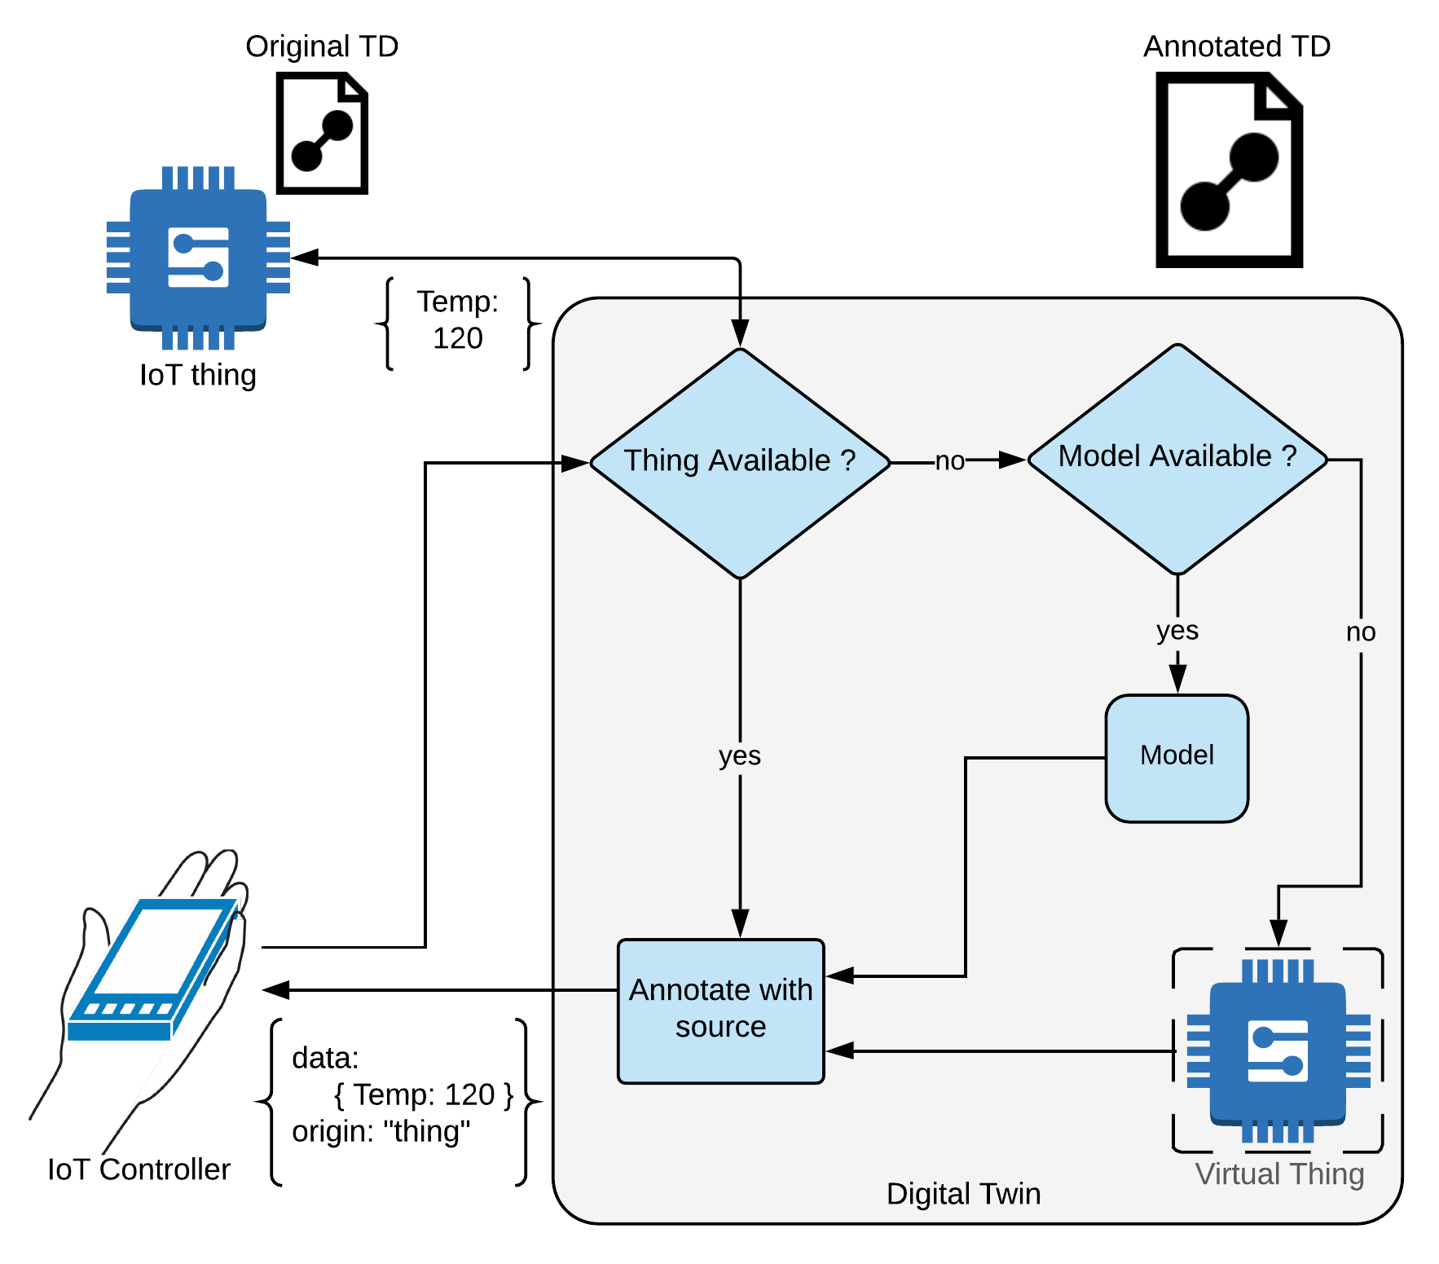
Taking Things a Step Further...
What if a thing is not always available ?
Augment it with an identical virtual thing to create a Digital Twin
The Digital Twin acts as a reverse proxy
Automatic transition between the two
With the ability to write you own data generation models

Slide 8
Limitations
Virtual-Thing can‘t copy href and contentType due to node-wot use
Can only send JSON due to node-wot use
Node-wot does not pass on event subscription / cancellation data
Event subscriptions do not handle connection loss correctly

Slide 9

Thank you

